Slide 1

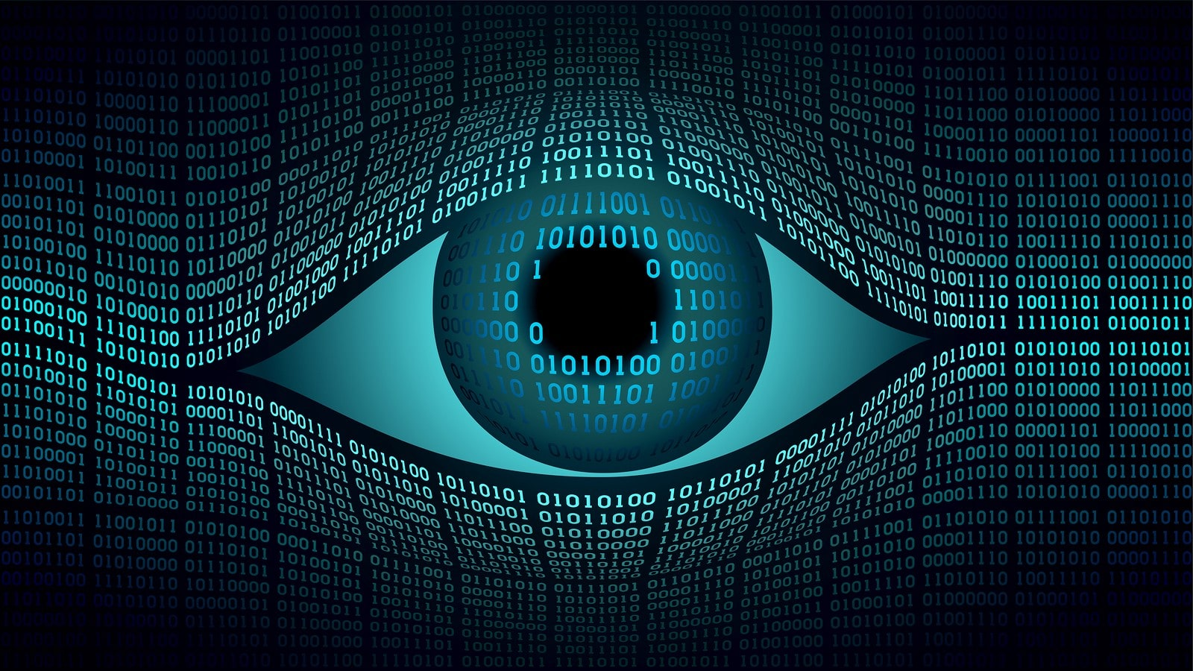
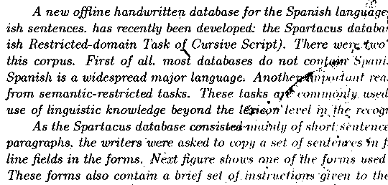
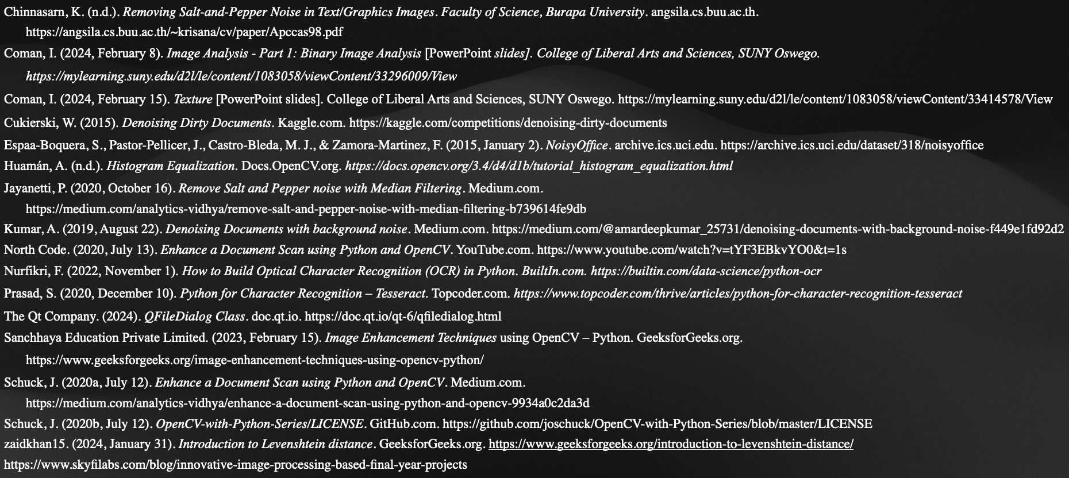
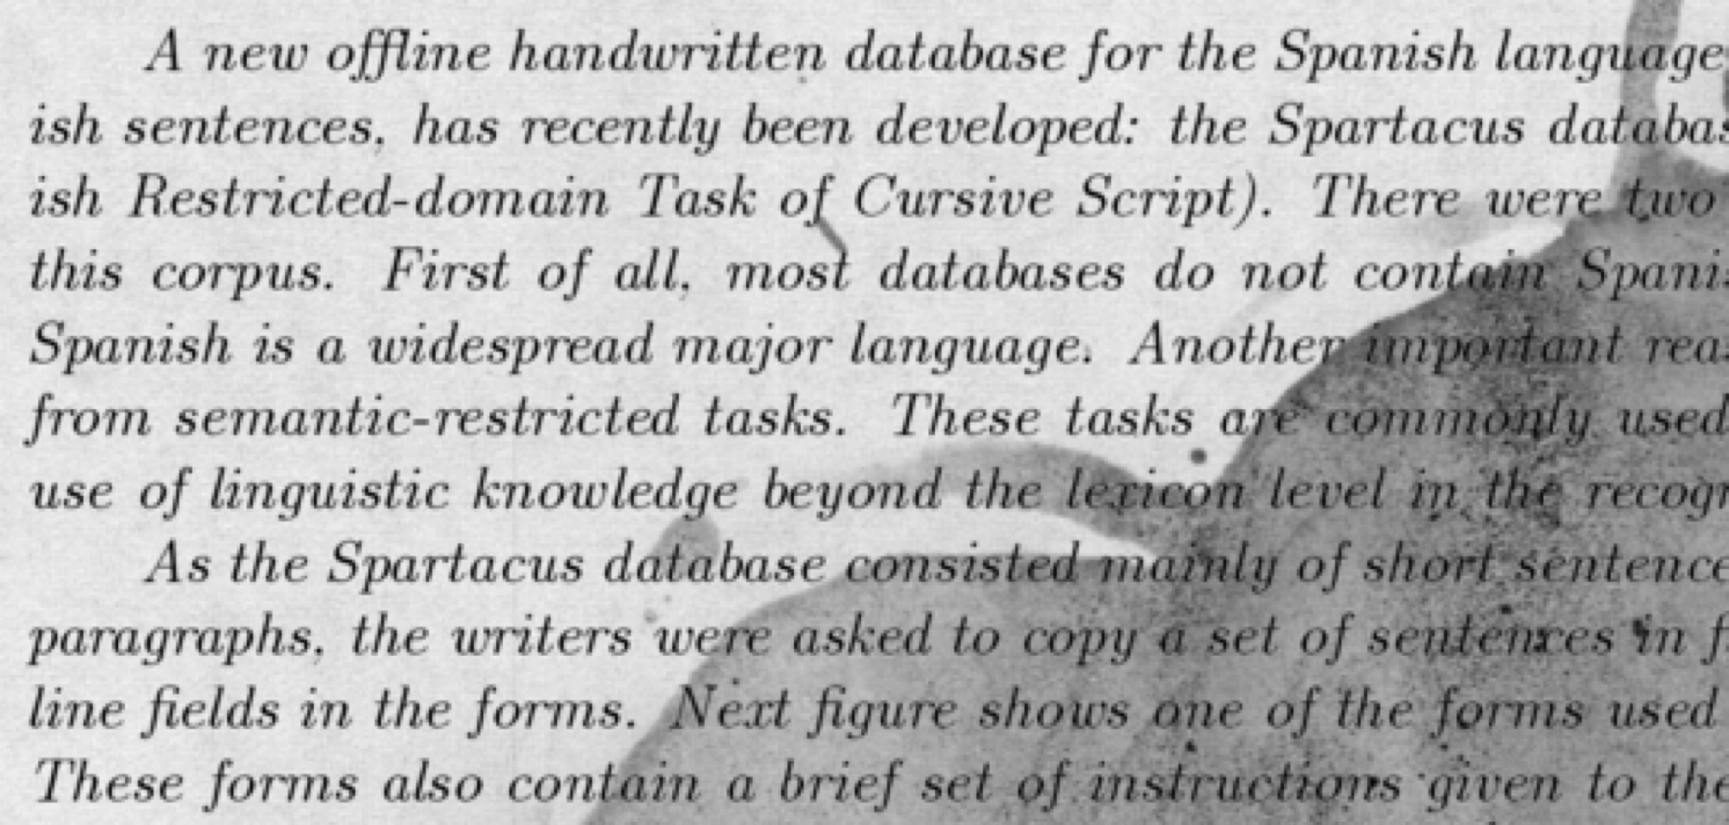
Text Document Enhancement with Image Processing
Justyce Countryman | SUNY Oswego
Project Vision & Purpose
Image Preprocessing Techniques
Determining The Best Method
Where Do We Go From Here?
Text documents may consist of a noisy background that are difficult for computers and people to interpret:
Stains
Eraser Marks
Fold Creases
Salt and Pepper Noise
Significant real-world benefits include:
Restoring old, distorted, and/or historical documents.
Increasing text visibility, which is especially advantageous for visually impaired individuals
Useful for researching ideal preprocessing techniques for all kinds of noise.
Thresholding
Otsu’s Thresholding
Automatically calculates an optimal threshold value that separates the foreground from the background
Binary Thresholding
Allows the user to manually input a threshold value.
Convenient because Otsu’s method could worsen the noise.
Adaptive Thresholding
Divides an image into regions and calculates thresholds for each region.
Computed by either taking the mean of the region or through a weighted sum, and then subtracted by a constant
Mathematical Morphology
Opening
Dilate and then erode image regions
Useful to remove small objects, lines, and bridges
Closing
Erode and then dilate image regions
Helps with eliminating holes and filling gaps
Filtering
Median Filtering
For every pixel, set that pixel to the median value based on a certain size of neighboring pixels
Preserves edges
Gaussian Blur
Same idea as median filtering, except instead of the median, it’s a weighted sum
Bilateral Filtering
Considers neighboring pixels and their intensity differences.
Results in only nearby and similar pixels being blurred
Reduces “salt-and-pepper” noise
There is no ”one-size-fits-all” solution for enhancing text documents.
However, there are algorithms that find the best image that a computer understands.
A “text extraction accuracy” is calculated through the “Levenshtein Distance” algorithm
Calculates the distance required to go from one list of characters to another.
Ex: Going from ”You are sitting” to “You are a kitten” requires two words to be modified.
The accuracy is calculated as ((max_cost - calculated_cost) / max_cost) * 100
Useful for when there is a noisy and clean version of the same image.
Most effective preprocessing methods to remove specific types of noise:
Stains -> Adaptive thresholding
Eraser marks -> Otsu’s or binary thresholding
Fold creases -> Otsu’s or binary thresholding
Salt and pepper noise -> Bilateral filtering
Custom-made image preprocessing algorithms could be created based on which ones were the most successful
Additional real-world applications include training machine learning algorithms, medical imaging, object detection/recognition
The Levenshtein distance will help in determining the best preprocessing technique, as well as the best parameters when given a noisy image
Advantageous features to add to software that utilizes binary images, like PDF scanning apps.
Project Algorithm
Allow the user to select an image preprocessing technique
Practical options currently include Otsu’s, binary, and adaptive thresholding, opening/closing morphology, and bilateral filtering
Obtain an image (preferably a text document)
Calculate the grayscale version of the image
Perform the user-selected preprocessing technique with the OpenCV library on Python and display the resulting binary image.
Dynamically update the image based on additional user-input
Allow the user to extract text via Tesseract.
References

